Slide 1
Poetry Terms
Complete your notes as we review the definitions of the following vocabulary

Slide 3
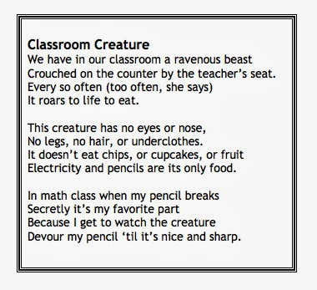
How many stanzas? _______
How many lines?_________
How many line breaks?
_________

Slide 6
Identify the rhyme scheme

Slide 8
Is this poem free verse? ________

Slide 10
Underline the examples of repetition

Slide 12
Circle alliteration & underline assonance
What is this an example of?
_____________

Slide 14
What is the tone?
Light
Serious
Angry
Gloomy

Slide 16
What is the mood?
Romantic
Sorrowful
Happy
Gloomy

Slide 19
What picture do you see?
Draw it! Underline the words that created your image.

Slide 21
What does creature symbolize in the poem? _____________________

Slide 23
What did you expect the creature to be at first? ________________________ What was it? ________________________

