Slide 1
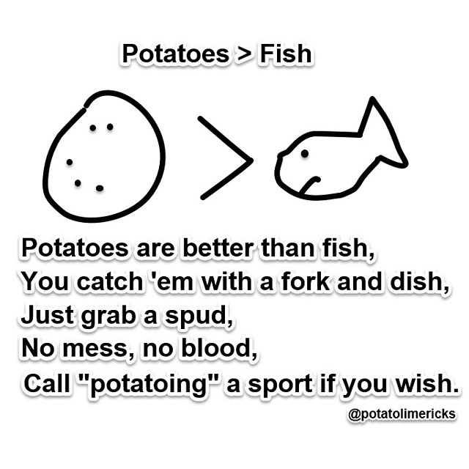
Limerick
A limerick is a five-line poem with the rhyme scheme AABBA.
*Limericks are meant to be funny. They often contain hyperboles, onomatopoeia,
and other forms of figurative language.

Slide 2
Limericks
.
1. Click on the following link to read a few limericks.
http://www.brownielocks.com/kidlimericks.html
:
2. View the limerick video.

Slide 3
Writing Limericks:
There was an old man on a _____________
Who seldom, if ever, stood _____________
He ran up and _____________
In his Grandmother’s _____________
Which adorned that old man on a _____________
There was an old person of _____________
Who rushed through a field of blue _____________
But some very large _____________
Stung his nose and his _____________
So he very soon went back to the _____________

Slide 4
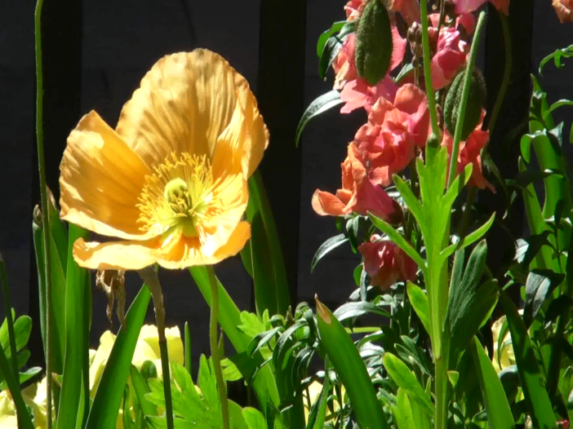
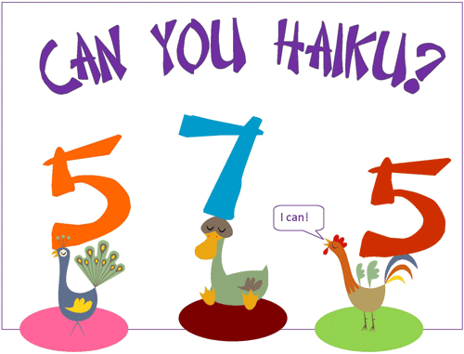
Haiku
What is a haiku?
Click the following link to find out.
https://www.youtube.com/watch?v=gOMuVpN8XqM

Slide 6
Class Haiku
Topic: _____________________
_____________________ (5)
________________________________ (7)
_____________________ (5)

Slide 7
Class Haiku
Topic: Reading
Reading is so cool, (5)
but math is also fun too. (7)
Which do you like most? (5)

Slide 8
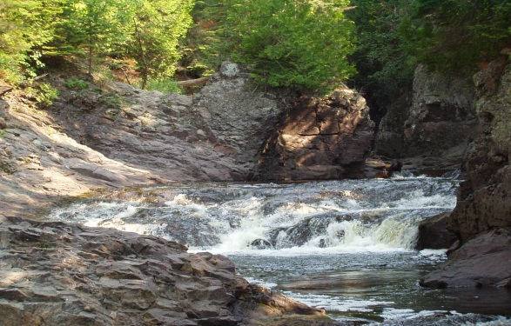
Haiku: Your Turn
Write YOUR OWN HAIKU following the correct syllable format: 5 7 5
Many haikus describe something in nature, but you can be creative as you’d like!
Rain Winter Cupcakes
Marshmallows Pizza

Slide 10
Traditionally…

Slide 11
Example Cinquains

Slide 13
Example of Free Verse

Slide 14
Free Verse: Bio Poem
Ms. Paoletto
Dedicated, trustworthy, caring
Lover of shopping, Pinterest, and Outback!
Who is able to see the good in others
Who feels cold most of the time!
Who wonders what the future will bring.
Who fears making quick decisions
Who would like to see the world
Who dreams all students will succeed!

